Slide 1
NLP

Slide 2
Introduction to NLP
The Penn Treebank

Slide 3
Description
Background
From the early ‘90s
Developed at the University of Pennsylvania
(Marcus, Santorini, and Marcinkiewicz 1993)
Size
40,000 training sentences
2,400 test sentences
Genre
Mostly Wall Street Journal news stories and some spoken conversations
Importance
Helped launch modern automatic parsing methods

Slide 4
External links
Treebank-3
http://catalog.ldc.upenn.edu/LDC99T42
Original version
http://catalog.ldc.upenn.edu/LDC95T7
Tokenization guidelines
http://www.cis.upenn.edu/~treebank/tokenization.html
The American National Corpus
http://www.anc.org

Slide 5
Penn Treebank Tagset (1/2)
Tag | Description | Example
CC | coordinating conjunction | and
CD | cardinal number | 1, third
DT | determiner | the
EX | existential there | there is
FW | foreign word | d‘oeuvre
IN | preposition/subordinating conjunction | in, of, like
JJ | adjective | green
JJR | adjective, comparative | greener
JJS | adjective, superlative | greenest
LS | list marker | 1)
MD | modal | could, will
NN | noun, singular or mass | table
NNS | noun plural | tables
NNP | proper noun, singular | John
NNPS | proper noun, plural | Vikings
PDT | predeterminer | both the boys
POS | possessive ending | friend's

Slide 6
Penn Treebank Tagset (2/2)
Tag | Description | Example
PRP | personal pronoun | I, he, it
PRP$ | possessive pronoun | my, his
RB | adverb | however, usually, naturally, here, good
RBR | adverb, comparative | better
RBS | adverb, superlative | best
RP | particle | give up
TO | to | to go, to him
UH | interjection | uhhuhhuhh
VB | verb, base form | take
VBD | verb, past tense | took
VBG | verb, gerund/present participle | taking
VBN | verb, past participle | taken
VBP | verb, sing. present, non-3d | take
VBZ | verb, 3rd person sing. present | takes
WDT | wh-determiner | which
WP | wh-pronoun | who, what
WP$ | possessive wh-pronoun | whose
WRB | wh-abverb | where, when

Slide 7
Example Sentence
WSJ/12/WSJ_1273.MRG, sentence 11
Because the CD had an effective yield of 13.4 % when it was issued in 1984 , and interest rates in general had declined sharply since then , part of the price Dr. Blumenfeld paid was a premium -- an additional amount on top of the CD 's base value plus accrued interest that represented the CD 's increased market value .

Slide 8
Parsed Sentence
(S
(SBAR-PRP
(IN Because)
(S
(S
(NP-SBJ (DT the) (NNP CD))
(VP
(VBD had)
(NP
(NP (DT an) (JJ effective) (NN yield))
(PP (IN of) (NP (CD 13.4) (NN %))))
(SBAR-TMP
(WHADVP-4 (WRB when))
(S
(NP-SBJ-1 (PRP it))
(VP
(VBD was)
(VP
(VBN issued)
(NP (-NONE- *-1))
(PP-TMP (IN in) (NP (CD 1984)))
(ADVP-TMP (-NONE- *T*-4))))))))
...

Slide 9
(VP
(VBD was)
(NP-PRD
(NP (DT a) (NN premium))
(: --)
(NP
(NP
(NP (DT an) (JJ additional) (NN amount))
(PP-LOC
(IN on)
(NP
(NP (NN top))
(PP
(IN of)
(NP
(NP (DT the) (NNP CD) (POS 's))
(NN base)
(NN value))))))
(CC plus)
(NP (VBN accrued) (NN interest)))
(SBAR
(WHNP-2 (WDT that))
(S
(NP-SBJ (-NONE- *T*-2))
(VP
(VBD represented)
(NP
(NP (DT the) (NNP CD) (POS 's))
(VBN increased)
(NN market)
(NN value)))))))
(. .))
(, ,)
(NP-SBJ
(NP (NN part))
(PP
(IN of)
(NP
(NP (DT the) (NN price))
(SBAR
(WHNP-3 (-NONE- 0))
(S
(NP-SBJ (NNP Dr.) (NNP Blumenfeld))
(VP (VBD paid) (NP (-NONE- *T*-3))))))))

Slide 10
Peculiarities
Complementizers
e.g., “that”
Gaps
*NONE*
SBAR
SBAR → COMP S
E.g., “that *NONE* represented the CD’ market value”

Slide 11
tgrep
A < B A immediately dominates B A << B A dominates B A <- B B is the last child of A A <<, B B is a leftmost descendant of A A <<` B B is a rightmost descendant of A A . B A immediately precedes B A .. B A precedes B A $ B A and B are sisters A $. B A and B are sisters and A immediately precedes B A $.. B A and B are sisters and A precedes B

Slide 12
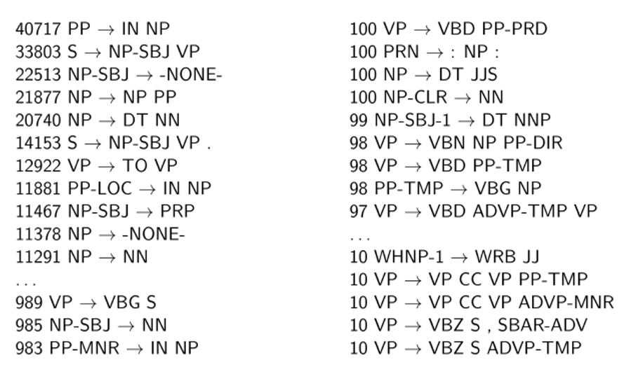
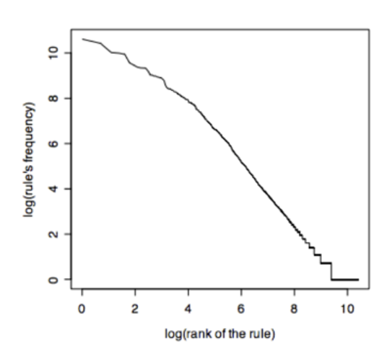
Penn Treebank Statistics

Slide 13
The use of treebanks
Disadvantages
A lot more work to annotate 40K+ sentences than to write a grammar.
Advantages
Statistics about different constituents and phenomena
Training systems
Evaluating systems
Multilingual extensions

Slide 14
Introduction to NLP
Issues with Context-free Grammars

Slide 15
Agreement
Number
Chen is/people are
Person
I am/Chen is
Tense
Chen was reading/Chen is reading/Chen will be reading
Case
not in English but in many other languages such as German, Russian, Greek
Gender
not in English but in many other languages such as German, French, Spanish

Slide 16
Combinatorial explosion
Many combinations of rules are needed to express agreement
S → NP VP
S → 1sgNP 1sgVP
S → 2sgNP 2sgVP
S → 3sgNP 3sgVP
…
1sgNP → 1sgN
...

Slide 17
Subcategorization frames
Direct object
The dog ate a sausage
Prepositional phrase
Mary left the car in the garage
Predicative adjective
The receptionist looked worried
Bare infinitive
She helped me buy this place
To-infinitive
The girl wanted to be alone
Participial phrase
He stayed crying after the movie ended
That-clause
Ravi doesn’t believe that it will rain tomorrow
Question-form clauses
She wondered where to go
Empty (φ)
She slept
Notes:
CHECK PROVENANCE

Slide 18
CFG independence assumptions
Non-independence
All NPs
11% NP PP, 9% DT NN, 6% PRP
NPs under S
9% NP PP, 9% DT NN, 21% PRP
NPs under VP
23% NP PP, 7% DT NN, 4% PRP
example from Dan Klein

Slide 19
Conclusions
Syntax helps understand the meaning of a sentence.
Bob gave Alice a flower
Who gave a flower to Alice?
What did Bob give to Alice?
Context-free grammars are an appopriate representation for syntactic information
Dynamic programming is needed for efficient parsing
Cubic time to find one parse
Still exponential time to find all parses
Why?

Slide 20
Answer
Why does it still take an exponential time to find all parses?
Very simple – because the number of parses can be exponential

Slide 21
NLP

